Slide 1
Titanic Data Set
MATH 4322 – Intro to Data Science and Machine Learning

Slide 2
Goal
Is to find out misclassification rate to determine if passengers survived or not
Is to find out what are the important predictors in determining the survival

Slide 3
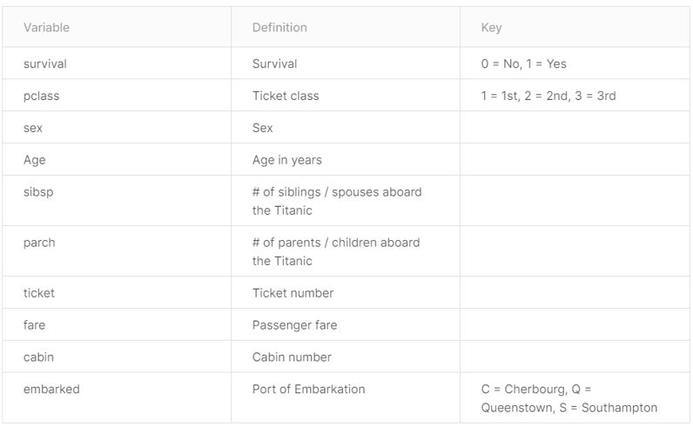
Predictors

Slide 4
Procedures
Download, combine and clean data to prepare for analysis
Removing insignificant predictors, converting to factors, removing or engineering NA value
Model 1: Logistic Regression
Prediction: We are wanted to predict if whether the observation will survive
Inference: Wanted to know what are the significant predictors that effected the survival.
Trying to find out which one results in a lower misclassification rate
Model 2: Classification Decision Trees
Creating a single tree
Pruning the tree
Using random forest to improve the test error

Slide 5
Data Cleaning
We removed unnecessary predictors such as name, ticket, and cabin number.
We changed predictors such as Sex, Emarked, and Pclass to categorical variables
For the NA values in the Age predictor, we replaced the NA values with the average age of the rest observations.

Slide 6
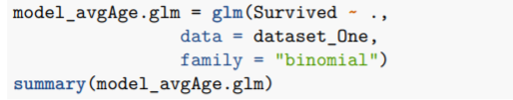
Model 1: (Multiple) Logistic Regression
We used logistic regression as this was a binary classification problem:
We used prediction on GLM model to predict survival based on multiple predictors.
Steps 1 and 2 : Create the model and get the summary

Slide 7
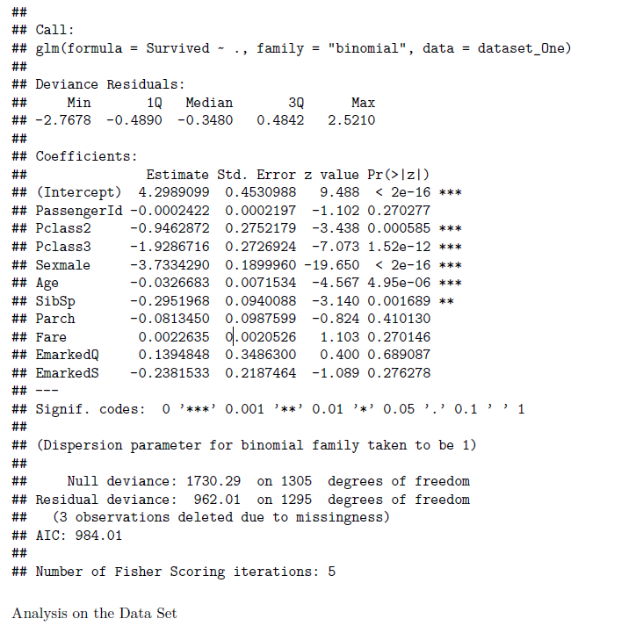
According to this data set, the most important predictors were Pclass(Ticket class), Sexmale, and Age.
Logit = 4.3 -0.94(PClass2) - 1.92(PClass3) - 3.73(SexMale) - 0.032(Age) - 0.29(SibSp)
Where Sex = 0 if female; 1 if male
Where PClass2 = O if Class is not 2;1 if Class=2, PClass3 = 0 if Class is not 3; 1 if Class=3
Analysis:
As the ticket class number, age, and the number of siblings/spouses increase, the probability of survival decreases.
Observation:
Being male decreases the chances of survival.

Slide 8

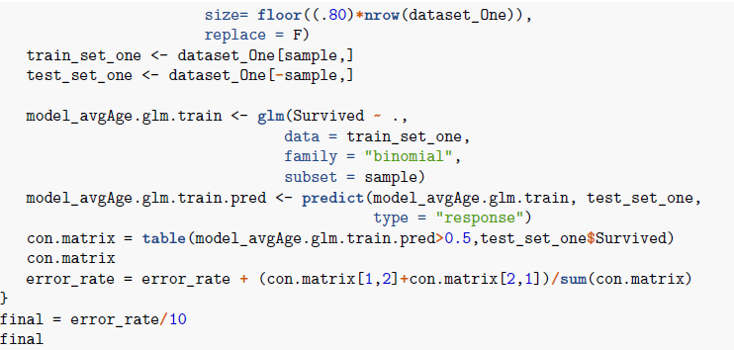

Step 3,4, and 5: Split the model into training and testing set, made a prediction and tested that prediction to get the error rate.

Slide 9
Result
According to the prediction, there was 14.8% misclassification on whether a passenger will survive or not.

Slide 10
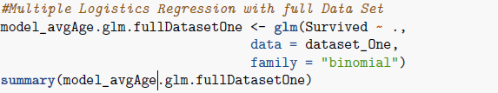
Now, we are going to make an inference too on the whole data set to find out the important predictors and to compare the test error rate.
Step 1 & 2 : Create a model and get the summary

Slide 11
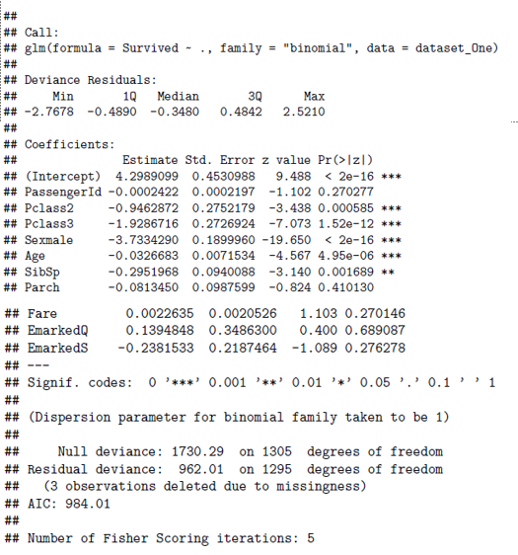
According to the inference, the most significant predictors are Pclass(Ticket class), Sexmale, and Age.
(Same as when we did prediction)

Slide 12
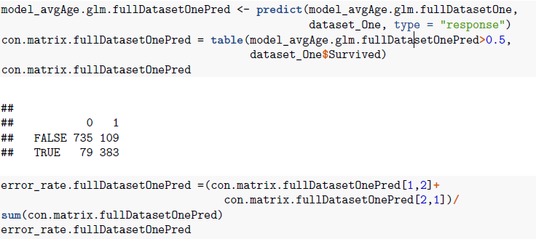
Step 3 , 4, and 5: same

Slide 13
Results
According to the inference, the most significant predictors are Pclass(Ticket class), Sexmale, and Age.
Observation: Prediction or inference did not make any significant changes to the results as they both share the same significant predictors and have similar error rates.
Overall, the misclassication rate was the about the same.
14.8% for prediction (splitted the data set intro training and testing)
14.4 % for inference ( used the full data set)

Slide 14
Model 2: Single Tree → Pruning & RF

Slide 15
Procedures
Model 2: Single Tree, Pruning, RF
Starting with dataset_One we create a classification tree, Prune the tree, and finally use random Forest, calculating Test Error at each step.
After finding the best method from the above statistical learning methods we apply ten iterations of that method and find the avg error from that.
Finally, the method is run with the full, unsplit, dataset.

Slide 16
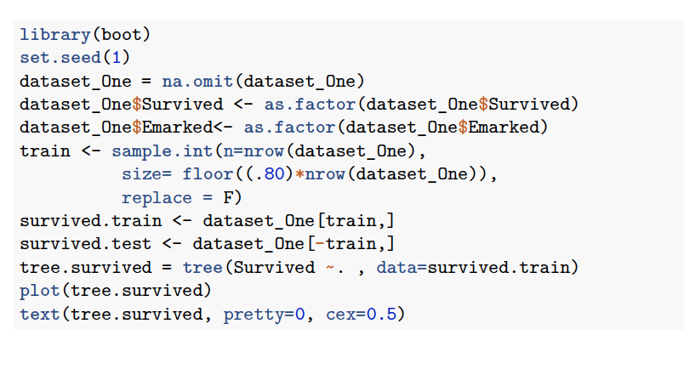
Steps
Creating a Single Tree

Slide 17
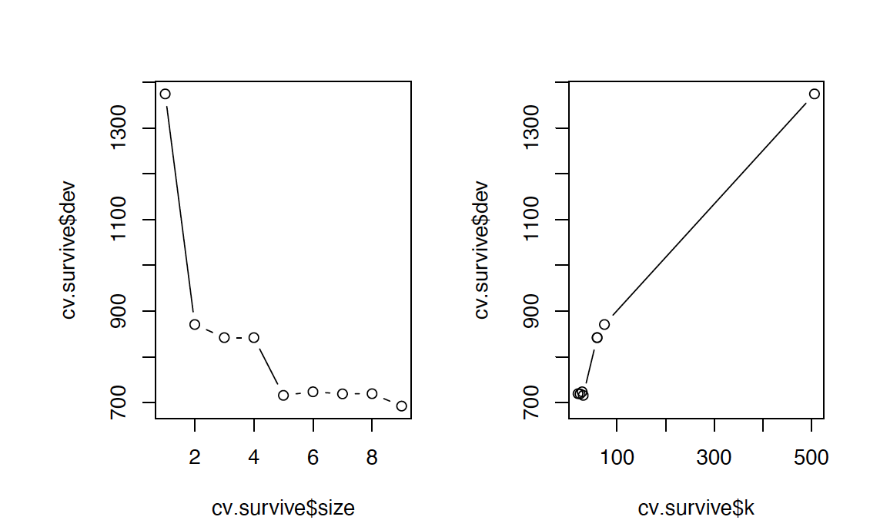
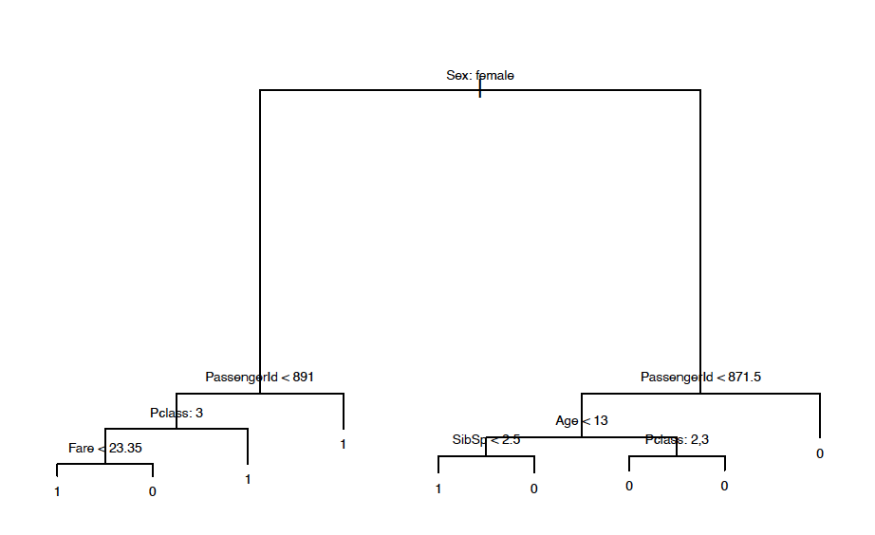
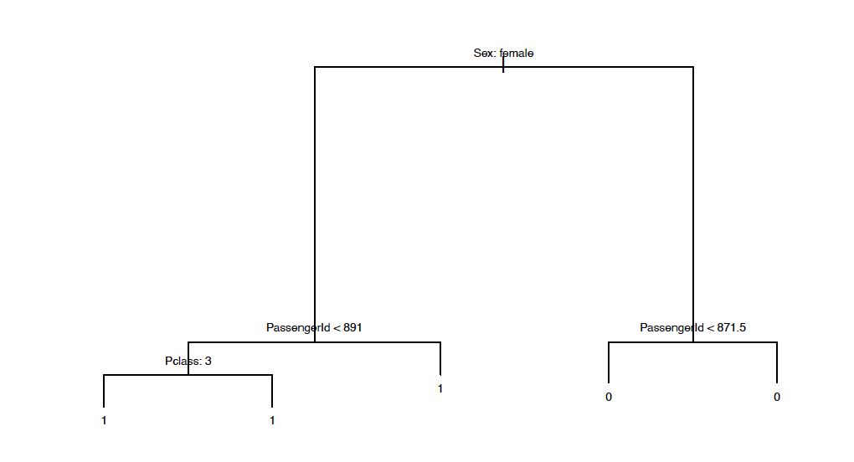
Steps: Pruning and getting the Error Rate
Test Error = 12.64%
Test Error = 14.66%

Slide 18
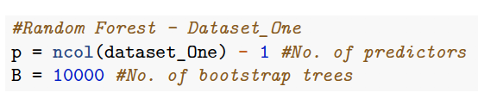
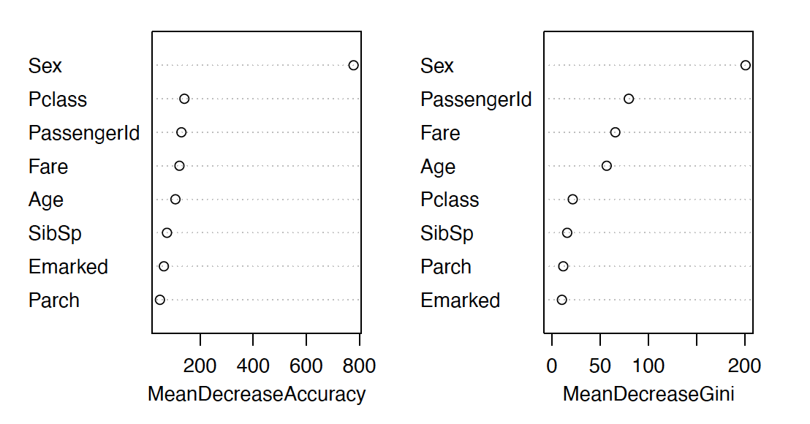
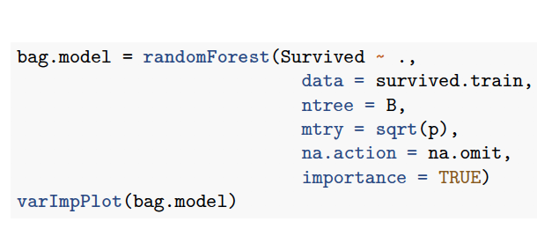
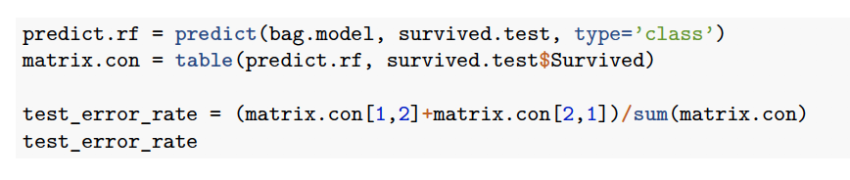
Steps: Random Forest to reduce error rate
Test Error = 10.7%

Slide 19
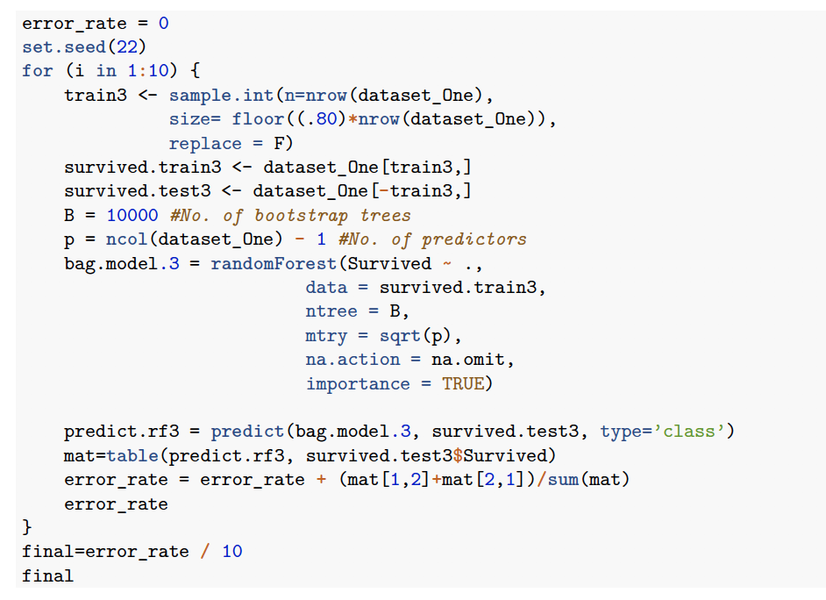
Doing 10 iterations
Test Error = 11.6%
on average

Slide 20
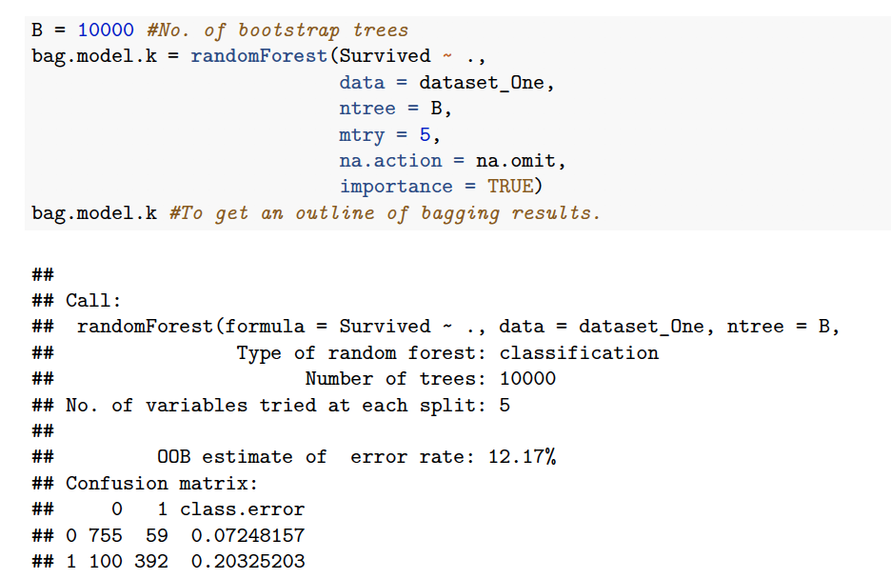
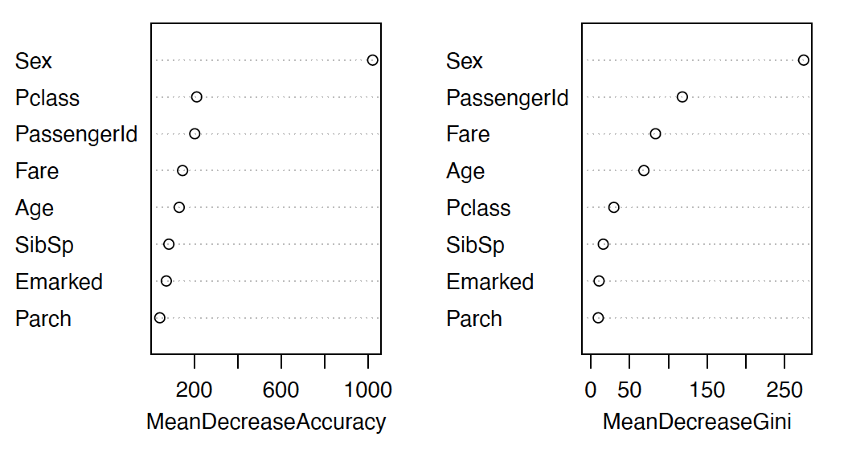
Random Forest on Full Data Set
Test Error = 12.17%

Slide 21
Conclusion
Model 1-Logistic Regression resulted in about 15% of misclassification rate
Model 2- Trees/ Random Forest resulted in about 12% of misclassification rate
The most important predictor when determining the survival was Sex.

